Slide 1
Music in the
Worship Space
Hymns, Choral Anthems, Instrumental Music
Why and How?

Slide 2
Congregation
For millennia the people of God have sung psalms as praise and prayer to God. Early Christians continued to sing, pray, and study the psalms, interpreting them in the light of Jesus’ life, death, and resurrection. Singing psalms remains an important part of the Reformed heritage. To the psalms the church began to add other hymns, canticles, and spiritual songs. Through the ages and from varied cultures, the church has developed many other forms of congregational song, accompanied by a great array of instruments. We draw from this rich repertoire in the Service for the Lord’s Day, singing glory to God.
(W-3.0203: Psalms, Hymns, and Spiritual Songs – Revised Directory for Worship)

Slide 3
Congregation
Prayer is a gift from God, who desires dialogue and relationship with us. It is a posture of faith and a way of living in the world. Prayer is also the primary way in which we participate in worship.
The singing of psalms, hymns, and spiritual songs is a vital and ancient form of prayer. Singing engages the whole person, and helps to unite the body of Christ in common worship.
The congregation itself is the church’s primary choir

Slide 4
Choir
The purpose of rehearsed choirs and other musicians is to lead and support the congregation in the singing of prayer.
Special songs, anthems, and instrumental music may also serve to interpret the word and enhance the congregation’s prayer.
“When we sing church hymns, we must be careful that we do not pronounce only the words with our tongues while our hearts wander elsewhere.” (St. John Chrysotom)

Slide 5
Instrumentalists
To lead the congregation in the singing of prayer is a primary role of the choir and other musicians. They also may pray on behalf of the congregation with introits, responses, and other musical forms.
Instrumental music may be a form of prayer since words are not essential to prayer.

Slide 6
Why are we singing “that” hymn?
Do Presbyterian’s follow the lectionary?
Many times the words of the [hymn are] taken directly from Scripture. In other words, the [hymn is ]an integral part of the liturgy. Because most of these (Catholic, Lutheran, Anglican) churches followed a lectionary, the choral director knew the Scripture passages for a given service far in advance.
If [we] ignore that integration between Scripture and anthem, [we] borrow only part of a tradition; the other part goes begging for attention. When it has no relationship to what precedes and follows in the order of worship, the anthem becomes “special music,” an intrusion in Reformed worship. It may be a beautiful intrusion, but it’s an intrusion nonetheless.
(“Choirs in Reformed Worship” by Emily R. Brink, Dec. 1986)

Slide 7
Resources
“Call To Worship: Lectionary Aids…”
The Presbyterian Hymnal
hymnary.org
jwpepper.com (lectionary search)
Other online searches/sources

Slide 8
February 22, 2015
First Sunday in Lent
Lectionary Readings (give brief idea of each)
Hymn Suggestions
Anthem & Music Suggestions

Slide 9
Hymn Searching
Using our hymnal
  Listing of Bible references (not complete)
  Index by topic
  Organization by “type”
  “We” v “I” hymns

Slide 10
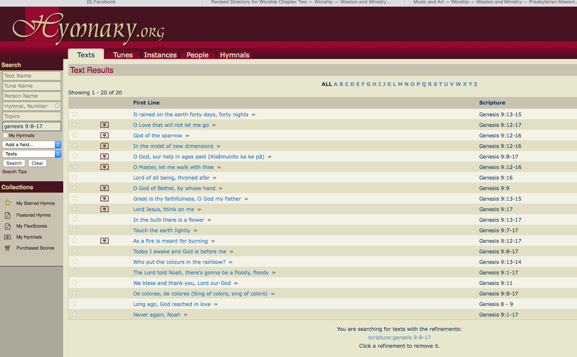
Hymn Searching Online

Slide 11
What did Megan do?
February 22, 2015
Opening Hymn: This Is My Father’s World (293)
Sermon Hymn: O Love, That Will Not Let Me Go (384)
Closing Hymn: O Love, How Deep, How Broad, How High (verses 1, 2 and 5) (83)
Choir: “Give Me Jesus (w/Jesus Paid it All)” and “What Wondrous Love Is This” (w/congregation)

Slide 12
Congregational Singing
Unifies the Congregation
  Prepares us, together, for worship and to hear God’s word
  Robert Shaw, “That’s the point of the choir or a congregation, doing the same thing together, at the same time.”
  2 Chronicles 5:13 “Those who blew the trumpets and those who sang together sounded like one person as they praised and thanked the Lord. They sang as others played their trumpets, cymbals, and other instruments.”

Slide 13
Congregational Singing
What a great way to praise and pray to, the Lord!
  We unify and lift our voices to praise God for the wonderful gift of grace
  We unify and lift our voices to pray to God for strength and perseverance
  We unify and lift our voices to exclaim the beauty of God’s creation

Slide 14
Congregational Singing
Aid in Teaching
  “Let the teaching of Christ live in you richly. Use all wisdom to teach and instruct each other by singing psalms, hymns, and spiritual songs with thankfulness in your hearts to God.” Colossians 3:16

Slide 15
Sing to the Lord!
May others who come and join us during our times of worship and singing see in us an expression of joy and truth which will impress upon them of the reality of the One we sing about. (Hank Wichers, “Some Thoughts on Congregational Singing” May 2, 2014, Counsel)
“Sing out, Louise!” (Gypsy)

