Slide 1
Jesus In Nature
A Closer Look at Three Advent Carols

Slide 2
The Lamb
Poem by William Blake (1757-1827)
Counterpart to the poem “The Tyger” (from “Songs of Experience)
From “Songs of Innocence” , published in 1789
Like the other poems from these collections, they were meant to be sung – original music has been lost
Blake’s poetry (and his poem, The Lamb) has been set to music by classical British composers Benjamin Britten and Ralph Vaughn Williams

Slide 3
Little Lamb who made thee
Dost thou know who made thee
Gave thee life & bid thee feed.
By the stream & o'er the mead;
Gave thee clothing of delight,
Softest clothing wooly bright;
Gave thee such a tender voice,
Making all the vales rejoice!
Little Lamb who made thee
Dost thou know who made thee
Little Lamb I'll tell thee,
Little Lamb I'll tell thee!
He is called by thy name,
For he calls himself a Lamb:
He is meek & he is mild,
He became a little child:
I a child & thou a lamb,
We are called by his name.
Little Lamb God bless thee.
Little Lamb God bless thee.

Slide 4
The Lamb
Comparing “little lamb” to the infant Jesus
LAMB
Pure & gentle creature
Tender voice
Softest clothing/bright
Meek and mild
Sacrifice
John 1:29: The next day he [John the Baptist] saw Jesus coming toward him and declared, “Here is the Lamb of God who takes away the sin of the world!

Slide 5
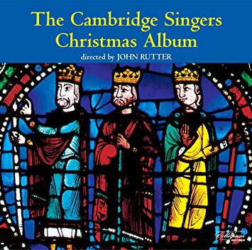
“The Lamb” by John Tavener
The Cambridge Singers directed by John Rutter

Slide 6
Jesus Christ the Apple Tree
First publication (as a poem) in 1761. Attributed to “RH” (presumably Rev. Richard Hutchins, a Calvinist Baptist in England)
Became popular in American hymnals in 1784 in New Hampshire
Tune by Elizabeth Poston (1905-1987) became most well known
Apple trees were popular and important in New England – tradition of wassailing (taken from England) on Christmas Eve which health to apple trees & apple cider saved many pilgrims when drinking water could make folks sick (typhus)
Nothing in text refers to either Advent or Christmas

Slide 7
The tree of life my soul hath seen, Laden with fruit, and always green: The trees of nature fruitless be Compared with Christ the apple tree.
His beauty doth all things excel: By faith I know, but ne’er can tell The glory which I now can see In Jesus Christ the apple tree.
For happiness I long have sought, And pleasure dearly I have bought: I missed of all: but now I see ’Tis found in Christ the apple tree.
I’m weary with my former toil, Here I will sit and rest awhile: Under the shadow I will be Of Jesus Christ the apple tree.
This fruit doth make my soul to thrive, It keeps my dying faith alive; Which makes my soul in hast to be With Jesus Christ the apple tree.

Slide 8
Jesus Christ the Apple Tree
APPLE TREE
Tree of Knowledge
Good & Evil / Adam & Eve
Tree of the Cross
1 Corinthians 15:22 … for as all die in Adam, so all will be made alive in Christ.
The first tree ”we” all fell, the second tree we have been saved
Tree of Life
Other religions/philosophies include the idea of the cosmos with a tree
Genesis 3:22: Then the Lord God said, “See, the man has become like one of us, knowing good and evil; and now, he might reach out his hand and take also from the tree of life, and eat, and live forever”.
Book of Enoch 25:4-7: And as for this fragrant tree no mortal is permitted to touch it till the great judgement…It shall then be given to the righteous and holy. Its fruit shall be for food to the elect:...Then shall they rejoice with joy and be glad, And into the holy place shall they enter; And its fragrance shall be in their bones...

Slide 9
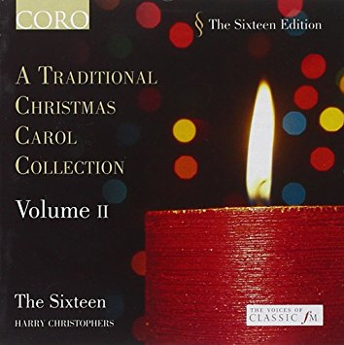
“Jesus Christ the Apple Tree” by Elizabeth Poston
The Sixteen &
Harry Christophers

Slide 10
Lo, How A Rose E’er Blooming
Marian hymn of German origin (“Es ist ein Ros entsprungen”, literal translation “a rose has sprung up”)
Unknown authorship
First in print in 1599, was harmonized by Michael Praetorius in 1609 and has hardly changed since.
Composed to be sung by a choir, not a soloist, has very typical rhythmic interest for the time
Originally had up to 23 verses. English translation (0f first three verses) by American musicologist, Theodore Baker (1851-1934)

Slide 11
Lo, how a rose e'er blooming From tender stem hath sprung, Of Jesse's lineage coming, As men of old have sung.
It came a flow'ret bright Amid the cold of winter When half-spent was the night.
Isaiah 'twas foretold it, This Rose that I have in mind.
And with Mary we behold it, The Virgin Mother so sweet and so kind. To show God's love aright, She bore to men a Savior When half-spent was the night.
O flower, who fragrance tender
With sweetness fills the air.
Dispel with glorious splendor
The darkness everywhere.
True man, yet very God,
From sin and death now save us,
And share our every load.

Slide 12
Lo How A Rose E’er Blooming
Prophetic theme
Praetorius was the son of a Lutheran pastor; developed musical forms based on Protestant hymns; took many Catholic ideas and transformed them for Protestant use
Original German
Rose = Mary
Branch of Jesse = Jesus (note: image of tree as Jesus was very popular in medieval times)
In medieval iconography, the tree of Jesse is often depicted as a rose plant.

Slide 13
Lo How A Rose E’er Blooming
Praetorius shifts focus from Mary to Jesus
Isaiah 11:1: A shoot shall come out from the stump of Jesse, and a branch shall grow out of his roots
Isaiah 35:1-2: The wilderness and the wasteland shall be glad for them, And the desert shall rejoice and blossom as the rose; ² It shall blossom abundantly and rejoice, Even with joy and singing. The glory of Lebanon shall be given to it, The excellence of Carmel and Sharon. They shall see the glory of the Lord, The excellency of our God.

Slide 14
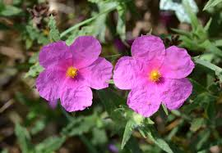
Lo How A Rose E’er Blooming
Song of Solomon 2:1: I am a rose^{[a]} of Sharon, a lily of the valleys.
Rose of Sharon
“Sharon” is a level place or a plain.
Large valley in Palestine where no “rose” (as we know it) grows.
Many scholars feel that this is in reference to the cistus or rock-rose, which is known for its soothing aroma and pain-relieving qualities
Isaiah 53:2a For he grew up before him like a young plant, and like a root out of dry ground;

Slide 15
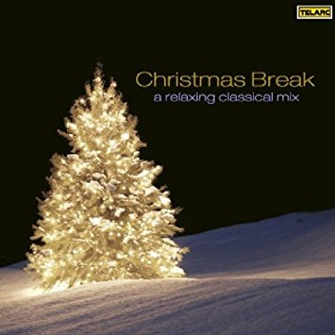
“Lo How A Rose E’er Blooming” by Michael Praetorius
Boston Symphony, Leonard Slatkin, Mormon Tabernacle Choir

