Slide 1
Matthew 25:35-40
Building congregational vitality
Dismantling structural racism
Eradicating systemic poverty

Slide 2
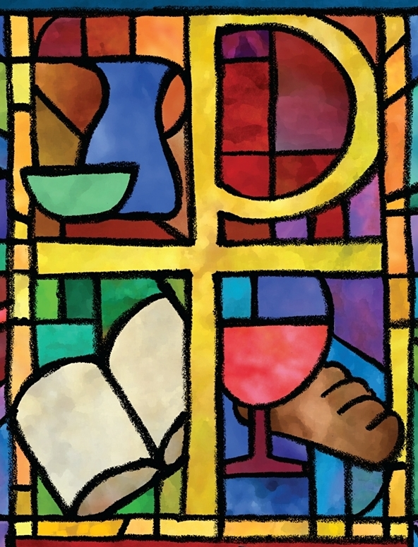
The PC(USA) Constitution on Building Congregational Vitality and Dismantling Structural Racism
Office of Theology and Worship Presbyterian Church (U.S.A.)
Name of Presenter

Slide 3
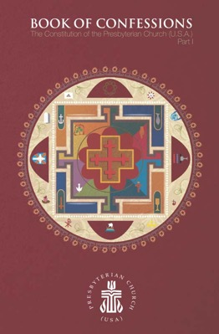
About This Presentation
All of the primary texts in this presentation come from the Constitution of the Presbyterian Church (U.S.A.), which is composed of The Book of Confessions (Part I) and The Book of Order (Part II).
Most images come from “Art in the Christian Tradition,” an online collection of the Jean and Alexander Heard Libraries of the Vanderbilt University Divinity School.

Slide 4
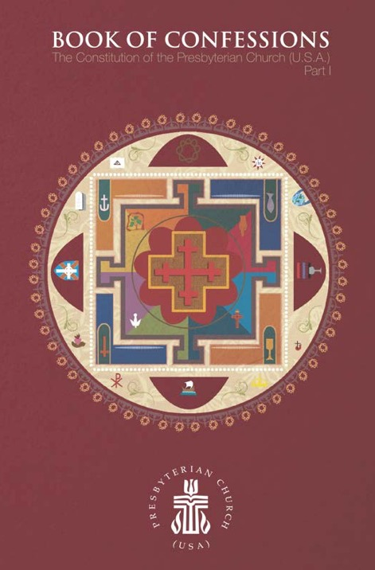
What Are the Confessions?
The Presbyterian Church (U.S.A.) states its faith and bears witness to God’s grace in Jesus Christ in the creeds and confessions in the Book of Confessions. In these statements the church declares to its members and to the world who and what it is, what it believes, and what it resolves to do. These statements identify the church as a community of people known by its convictions as well as by its actions. —Book of Order, F-2.01

Slide 5
The Confession of 1967
Written for the United Presbyterian Church in the United States of America, the Confession of 1967 sought to address critical issues for the church and society in the mid-twentieth century. A key theme is reconciliation.
This presentation highlights excerpts from the Confession of 1967 pertaining to the work of building congregational vitality and dismantling structural racism.

Slide 6
Questions for Discussion or Reflection
What does the Confession of 1967 have to say about building congregational vitality?

Slide 7
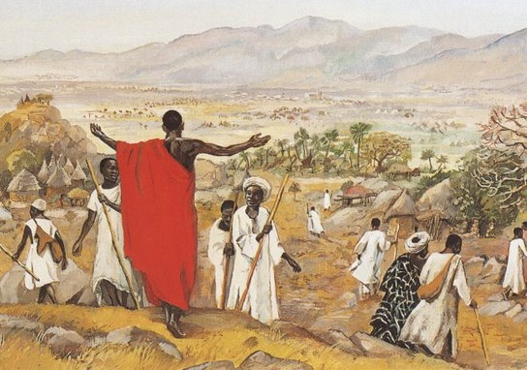
The Confession of 1967
Wherever the church exists, its members are both gathered in corporate life and dispersed in society for the sake of mission in the world. —Book of Confessions, 9.35
“The Mission to the World,” JESUS MAFA 1973

Slide 8
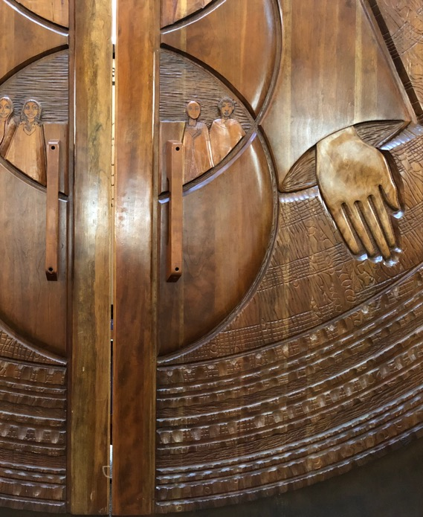
The Confession of 1967
The church gathers to praise God, to hear [God’s] word for [humankind], to baptize and to join in the Lord’s Supper, to pray for and present the world to [God] in worship, to enjoy fellowship, to receive instruction, strength, and comfort, to order and organize its own corporate life, to be tested, renewed, and reformed, and to speak and act in the world’s affairs as may be appropriate to the needs of the time. —Book of Confessions, 9.36
Presbyterian Center Chapel Doors, Federico Armijo, 1996

Slide 9
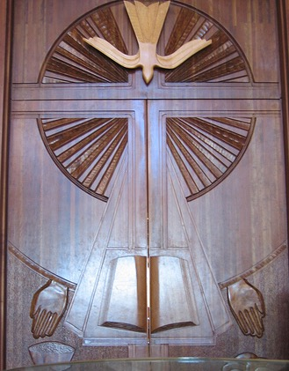
The Confession of 1967
The church disperses to serve God wherever its members are, at work or play, in private or in the life of society. Their prayer and Bible study are part of the church’s worship and theological reflection. Their witness is the church’s evangelism. Their daily action in the world is the church in mission to the world. The quality of their relation with other persons is the measure of the church’s fidelity. —Book of Confessions, 9.37
Presbyterian Center Chapel Doors, Federico Armijo, 1996

Slide 10
Questions for Discussion or Reflection
What does the Confession of 1967 have to say about dismantling structural racism?

Slide 11
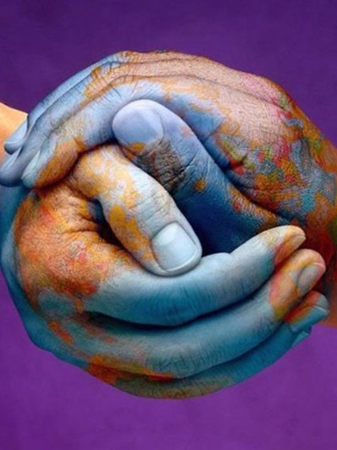
The Confession of 1967
God has created the peoples of the earth to be one universal family. In [God’s] reconciling love, [God] overcomes the barriers between [us] and breaks down every form of discrimination based on racial or ethnic difference, real or imaginary. The church is called to bring all [people] to receive and uphold one another as persons in all relationships of life: in employment, housing, education, leisure, marriage, family, church, and the exercise of political rights.
“Hands of the World,” Graphic Design for Movement for Peace, 21st Century

Slide 12
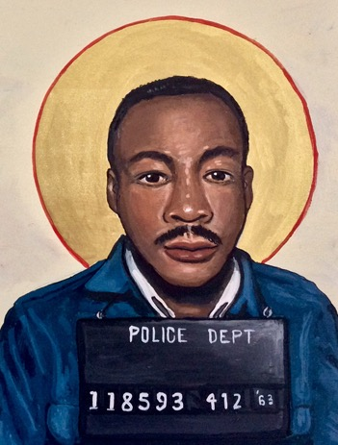
The Confession of 1967
Therefore, the church labors for the abolition of all racial discrimination and ministers to those injured by it. Congregations, individuals, or groups of Christians who exclude, dominate, or patronize [others], however subtly, resist the Spirit of God and bring contempt on the faith which they profess. —Book of Confessions, 9.44
“Martin Luther King Jr.,” Kelly Latimore, 2019

Slide 13
The Confession of Belhar
Written in the Dutch Reformed Mission Church in the context of South African apartheid, the Confession of Belhar was adopted in 1986. It condemns the sin of racism and calls for unity and justice in the church.
This presentation highlights excerpts from the Confession of Belhar pertaining to the work of building congregational vitality and dismantling structural racism.

Slide 14
Questions for Discussion or Reflection
What does the Confession of 1967 have to say about building congregational vitality?

Slide 15
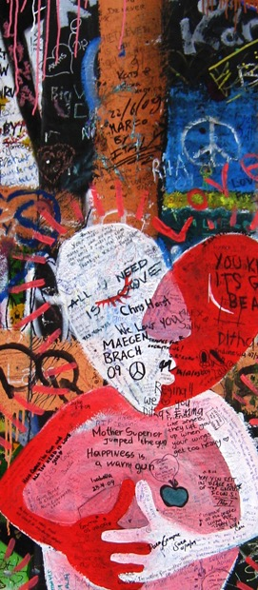
The Confession of Belhar
We believe
• that Christ’s work of reconciliation is made manifest in the church as the community of believers who have been reconciled with God and with one another;
• that unity is, therefore, both a gift and an obligation for the church of Jesus Christ; that through the working of God’s Spirit it is a binding force, yet simultaneously a reality which must be earnestly pursued and sought: one which the people of God must continually be built up to attain;
John Lennon Wall, Prague,
Czech Republic, 2009

Slide 16
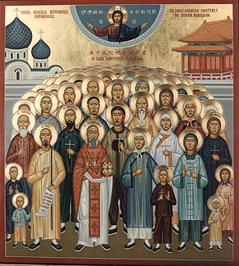
The Confession of Belhar
[We believe]
• that this unity must become visible so that the world may believe that separation, enmity and hatred between people and groups is sin which Christ has already conquered, and accordingly that anything which threatens this unity may have no place in the church and must be resisted;
“Chinese Martyrs,” Orthodox Icon, ca. 1900

Slide 17
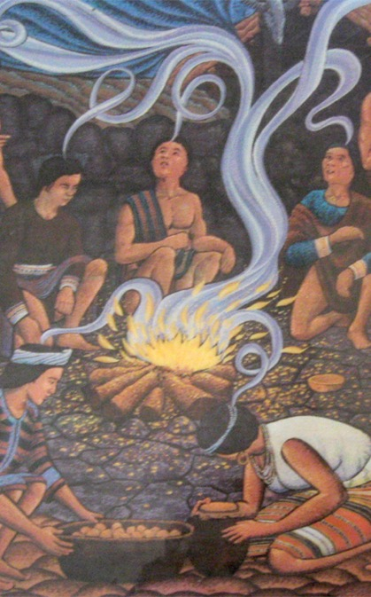
The Confession of Belhar
• that this unity of the people of God must be manifested and be active in a variety of ways:
° in that we love one another;
° that we experience, practice and pursue community with one another;
° that we are obligated to give ourselves willingly and joyfully to be of benefit and blessing to one another;
° that we share one faith, have one calling, are of one soul and one mind;
“Pentecost,” Bontoc, Philippines, 1980

Slide 18
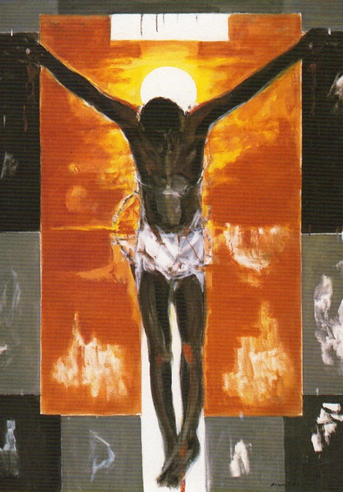
The Confession of Belhar
° have one God and Father, are filled with one Spirit, are baptized with one baptism, eat of one bread and drink of one cup, confess one name, are obedient to one Lord, work for one cause, and share one hope;
° together come to know the height and the breadth and the depth of the love of Christ;
° together are built up to the stature of Christ, to the new humanity;
“Cristo Negro,” Martin Ruiz Anglada, 1995

Slide 19
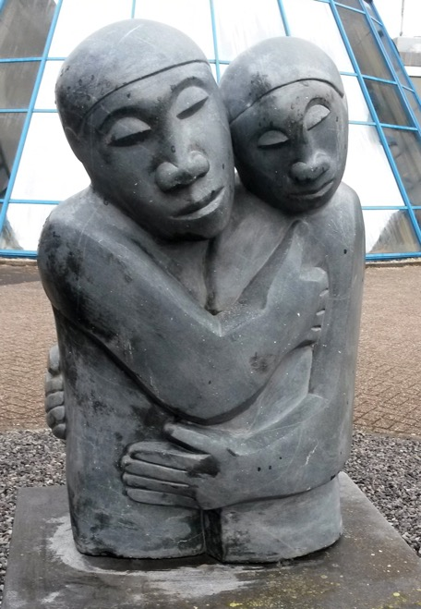
The Confession of Belhar
° together know and bear one another’s burdens, thereby fulfilling the law of Christ;
° that we need one another and upbuild one another, admonishing and comforting one another;
° that we suffer with one another for the sake of righteousness; pray together; together serve God in this world; and together fight against all which may threaten or hinder this unity;
“Reconciliation,” Amos Supuni, ca. 1991–2008

Slide 20
The Confession of Belhar
[We believe]
• that this unity can be established only in freedom and not under constraint; that the variety of spiritual gifts, opportunities, backgrounds, convictions, as well as the various languages and cultures, are by virtue of the reconciliation in Christ, opportunities for mutual service and enrichment within the one visible people of God;
• that true faith in Jesus Christ is the only condition for membership of this church. —Book of Confessions, 10.3
”Entry of Christ into Jerusalem,” Wilhelm Morgner, 1912

Slide 21
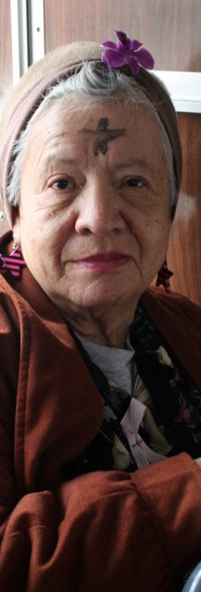
The Confession of Belhar
Therefore, we reject any doctrine
• which absolutizes either natural diversity or the sinful separation of people in such a way that this absolutization hinders or breaks the visible and active unity of the church, or even leads to the establishment of a separate church formation;
• which professes that this spiritual unity is truly being maintained in the bond of peace while believers of the same confession are in effect alienated from one another for the sake of diversity and in despair of reconciliation;
“Ash Wednesday,”
Art Siegel, 2006

Slide 22
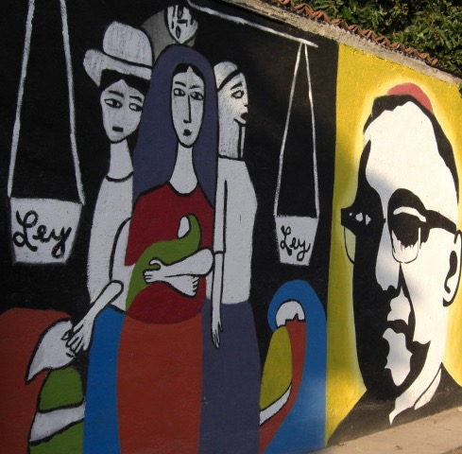
The Confession of Belhar
[Therefore, we reject any doctrine]
• which denies that a refusal earnestly to pursue this visible unity as a priceless gift is sin;
• which explicitly or implicitly maintains that descent or any other human or social factor should be a consideration in determining membership of the church. —Book of Confessions, 10.4
Mural of Monseñor Romero, El Salvador, 2007

Slide 23
Questions for Discussion or Reflection
What does the Confession of Belhar have to say about dismantling structural racism?

Slide 24
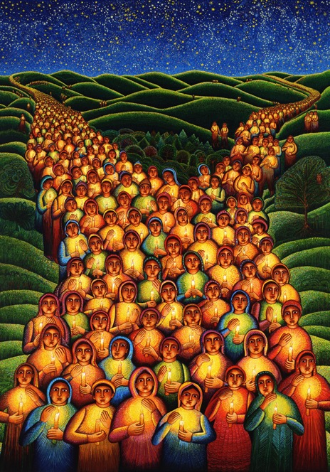
The Confession of Belhar
We believe
• that God has entrusted the church with the message of reconciliation in and through Jesus Christ;
• that the church is called to be the salt of the earth and the light of the world, that the church is called blessed because it is a peacemaker, that the church is witness both by word and by deed to the new heaven and the new earth in which righteousness dwells;
“Festival of Lights,” John August Swanson, 2000

Slide 25
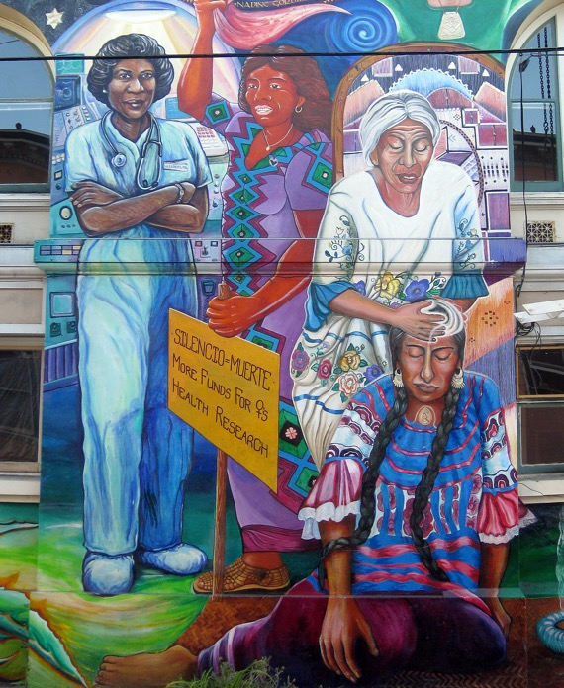
The Confession of Belhar
[We believe]
• that God’s life-giving Word and Spirit has conquered the powers of sin and death, and therefore also of irreconciliation and hatred, bitterness and enmity, that God’s life-giving Word and Spirit will enable the church to live in a new obedience which can open new possibilities of life for society and the world;
“Maestra Peace Mural,” Juana Alicia, 1994

Slide 26
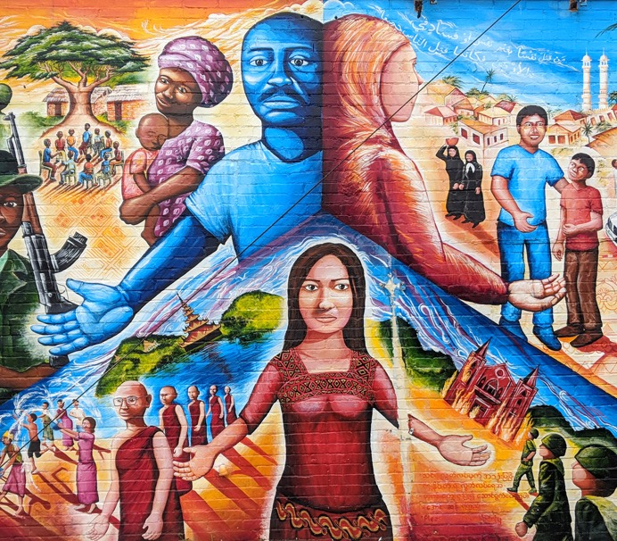
The Confession of Belhar
[We believe]
• that the credibility of this message is seriously affected and its beneficial work obstructed when it is proclaimed in a land which professes to be Christian, but in which the enforced separation of people on a racial basis promotes and perpetuates alienation, hatred and enmity;
“Global Refugee Mural,” Joel Burgner, 2009

Slide 27
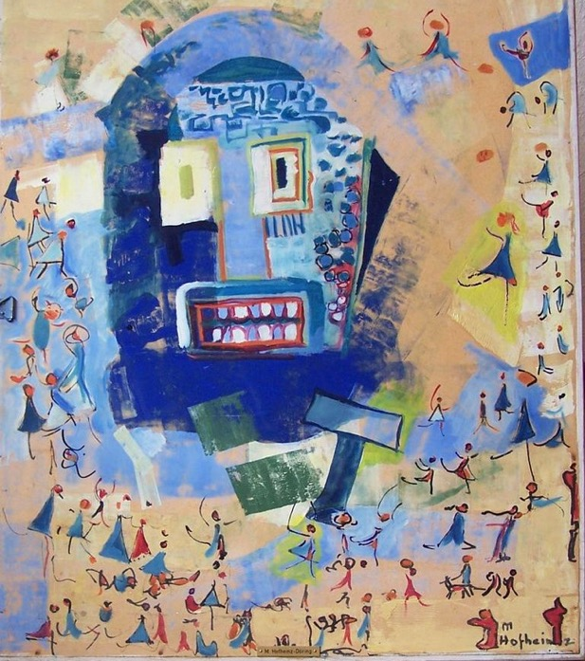
The Confession of Belhar
[We believe]
• that any teaching which attempts to legitimate such forced separation by appeal to the gospel, and is not prepared to venture on the road of obedience and reconciliation, but rather, out of prejudice, fear, selfishness and unbelief, denies in advance the reconciling power of the gospel, must be considered ideology and false doctrine. —Book of Confessions, 10.6
“Worship of the Golden Calf,” Margret Hofheinz-Döring, 1962

Slide 28
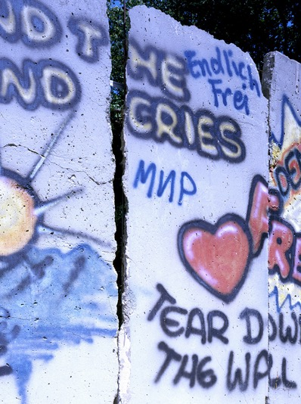
The Confession of Belhar
Therefore, we reject any doctrine which, in such a situation sanctions in the name of the gospel or of the will of God the forced separation of people on the grounds of race and color and thereby in advance obstructs and weakens the ministry and experience of reconciliation in Christ. —Book of Confessions, 10.6
Piece of the Berlin Wall, ca. 1989

Slide 29
A Brief Statement of Faith
Written in the time following the 1983 reunion that formed the Presbyterian Church (U.S.A.), A Brief Statement of Faith articulated the commitments and convictions of the new denomination. It is trinitarian in form and designed for use in worship.
This presentation highlights excerpts from A Brief Statement of Faith pertaining to the work of building congregational vitality and dismantling structural racism.

Slide 30
Questions for Discussion or Reflection
What does a Brief Statement of Faith have to say about building congregational vitality?

Slide 31
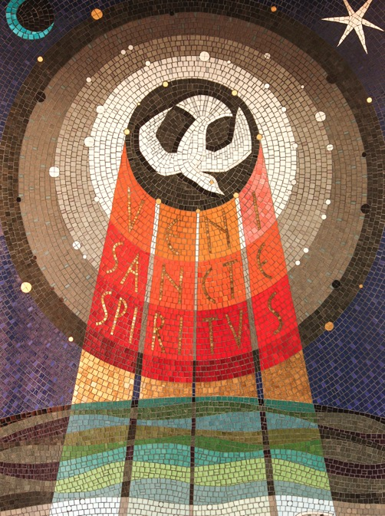
A Brief Statement of Faith
We trust in God the Holy Spirit, everywhere the giver and renewer of life.
“Veni Sancte Spiritus,” Adam Kossowski, 1965

Slide 32
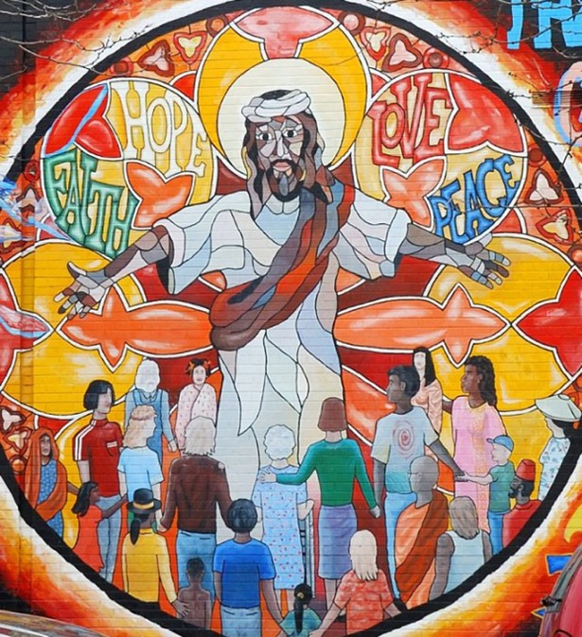
A Brief Statement of Faith
The Spirit justifies us by grace through faith, sets us free to accept ourselves and to love God and neighbor, and binds us together with all believers in the one body of Christ, the Church.
“Jesus Mural,” Chicago, United States, 20th Century

Slide 33
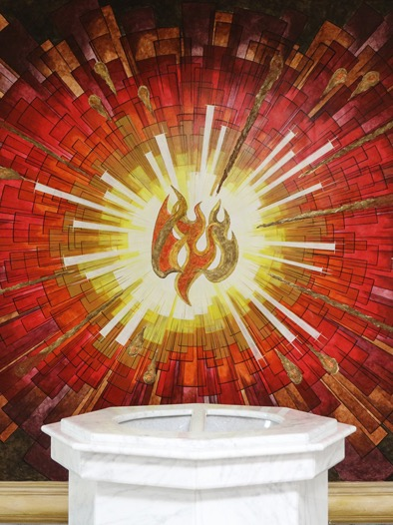
A Brief Statement of Faith
The same Spirit who inspired the prophets and apostles rules our faith and life in Christ through Scripture, engages us through the Word proclaimed, claims us in the waters of baptism, feeds us with the bread of life and the cup of salvation, and calls women and men to all ministries of the Church.
Baptismal Font, Mexicali, Mexico, 20th Century

Slide 34
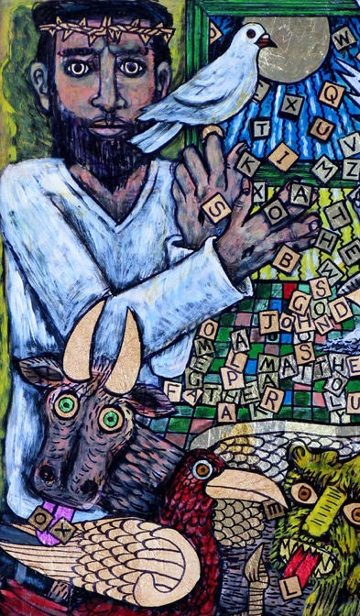
A Brief Statement of Faith
In a broken and fearful world the Spirit gives us courage to pray without ceasing, to witness among all peoples to Christ as Lord and Savior, to unmask idolatries in Church and culture, to hear the voices of peoples long silenced, and to work with others for justice, freedom, and peace.
“In the Beginning,” Brian Whelan, 2003

Slide 35
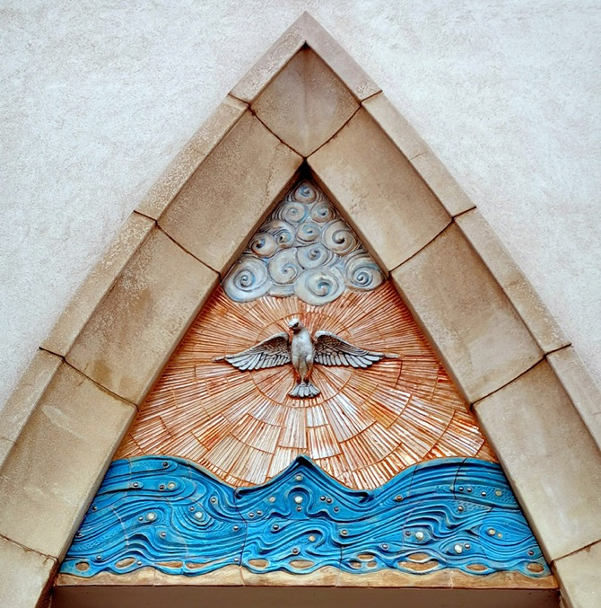
A Brief Statement of Faith
In gratitude to God, empowered by the Spirit, we strive to serve Christ in our daily tasks and to live holy and joyful lives, even as we watch for God’s new heaven and new earth, praying, “Come, Lord Jesus!”
—Book of Confessions, 11.4
“Coming of the Holy Spirit,” Eva Kun, 2016

Slide 36
Questions for Discussion or Reflection
What does a Brief Statement of Faith have to say about dismantling structural racism?

Slide 37
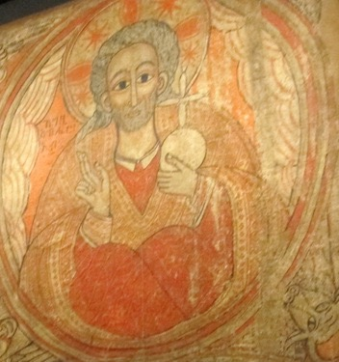
A Brief Statement of Faith
We trust in God, whom Jesus called Abba, Father.
Mural from the Church of Abba Antonius, Ethiopia, 1690–1710

Slide 38
A Brief Statement of Faith
In sovereign love God created the world good and makes everyone equally in God’s image, male and female, of every race and people, to live as one community.
“Be Thou My Vision,” Mike Moyers, 2013

Slide 39
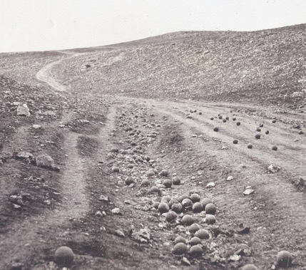
A Brief Statement of Faith
But we rebel against God; we hide from our Creator. Ignoring God’s commandments, we violate the image of God in others and ourselves, accept lies as truth, exploit neighbor and nature, and threaten death to the planet entrusted to our care. We deserve God’s condemnation.
“Valley of the Shadow of Death,” Roger Fenton, 1855

Slide 40
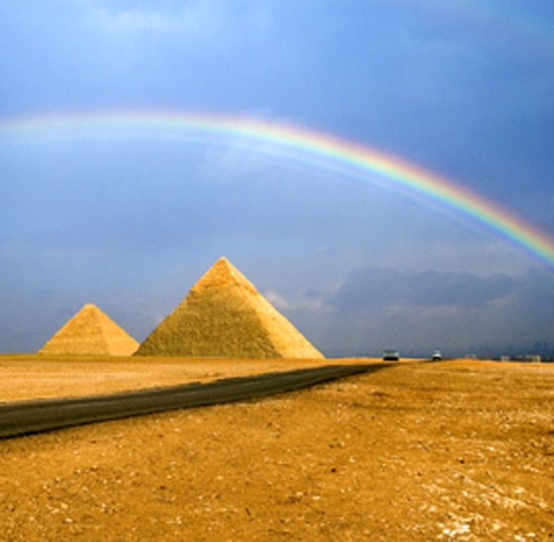
A Brief Statement of Faith
Yet God acts with justice and mercy to redeem creation.
In everlasting love, the God of Abraham and Sarah chose a covenant people to bless all families of the earth.
Hearing their cry, God delivered the children of Israel from the house of bondage.
“Rainbow Over the Pyramid,” Hai Thinh, 2008

Slide 41
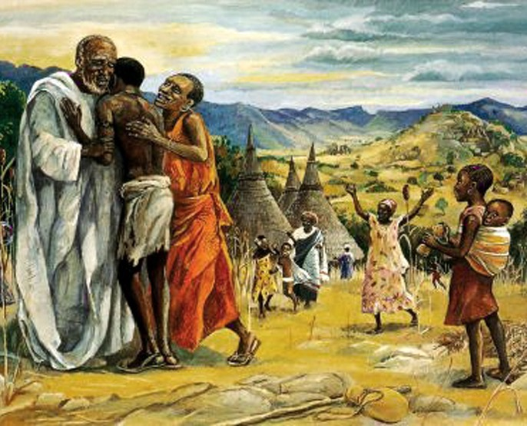
A Brief Statement of Faith
Loving us still, God makes us heirs with Christ of the covenant.
Like a mother who will not forsake her nursing child, like a father who runs to welcome the prodigal home, God is faithful still. —Book of Confessions, 11.3
”Prodigal Son,” JESUS MAFA, 1970

Slide 42
Matthew 25 Church Policies
The Book of Order contains Church policies that pertain to the work of building congregational vitality and dismantling structural racism.

Slide 43
The Foundations of Presbyterian Polity
The Foundations of Presbyterian Polity sets forth the principles that undergird the church’s mission, faith, and form of government.

Slide 44
The Form of Government
The Form of Government establishes the organization of the denomination, defining membership and ministry and determining structures of oversight for the church’s mission.

Slide 45
The Directory for Worship
The Directory for Worship presents the denomination’s theology and practice of worship, with an understanding of worship that includes service to God and neighbor.

Slide 46
Additional Resources
For more information on the Matthew 25 vision of the Presbyterian Church (U.S.A.), including resources for building congregational vitality, and dismantling structural racism visit pcusa.org/Matthew25.

Slide 47
Questions for Discussion or Reflection
How is our Church building congregational vitality?
How is our Church dismantling structural racism?
First Presbyterian Lansing’s Matthew 25 PP on building congregational vitality and dismantling structural racism.

