Slide 1
A Framework For Youth Success
Practical Actions to Help Children and Youth Flourish and Thrive

Slide 2
The Legacy Center for Community Success
Founded in Midland County in 2004 as a “Think and Do” Tank
Research on outside-the classroom factors that impede youth learning and development across the age spectrum from conception to adulthood
Design/Develop interventions that address the barriers identified in the research phase
Implement the interventions with these boundary limits
Use collaborating youth-serving partners to deliver programs
Define measures to track program outcomes
“Ruthlessly” measure program outcomes (whether and to what extent the desired outcomes are achieved)

Slide 3
Education Process
Shelter Preschool Curriculum Learning
Clothing Supplies Teaching Critical Thinking
Food Family Reading Problem Solving
Safety Funding Homework Leadership
Health Wellbeing
Principal Problem
Perceived Problem
“What’s Wrong with our Schools?”
Desired
Outcomes
Inputs
Process

Slide 4
The Legacy Center for Community Success
Research target areas
Early childhood
Brain development for learning
Ready For School
Child and family supports
Child Maltreatment Prevention (SEEK Program)
Elementary school students
Literacy and Numeracy proficiency
Child and family supports
Adolescents
Adult Brain formation
Developmental Assets

Slide 5
A Model for Youth Success
Research indicates certain Key Elements are needed for a child to be successful
Path to success will be very difficult if not impossible in their absence
A Model for Youth Success was developed over 2 years by ~200 professionals from child-serving organizations
Rooted in an integrated and systemic approach comprised of 4 Key Elements representing 3 critical dimensions needed to flourish and thrive
Physical
Social
Cognitive

Slide 6
A Framework for Youth Success Key Elements
Basic Needs and Safety
Physical Health
Wellbeing
Education
Goals
Social/Emotional/Spiritual Health
Provide supports for children from (pre)birth
Enhance parenting education
Inform and engage the community
Increase access to youth programs and services
Increase community collaboration and community partnerships
Build Developmental Assets among our youth

Slide 7
A Model for Youth Success
Basic Needs and Safety
Food
Shelter
Clothing
Transportation
Personal safety
Abuse
Neglect
Bullying
Violence
Drug and alcohol use
Physical Health
Pre- and Post-natal care
Vaccinations
Proper nutrition
Personal hygiene
Wellness physician care
Medical services
Physical activities/Fitness
Sexual health/Teen pregnancy avoidance
Dental care

Slide 8
A Model for Youth Success
Wellbeing
(Social/Emotional/Spiritual/Mental Health)
Developmental Assets
Constructive use of time
Social competencies
Positive values and identity
Commitment to learning
Support
Empowerment
Boundaries and expectations
Caring and supportive community
Mental and behavioral health services
Strengthening families
Parenting skills and engagement
Mentoring
Faith-based relationships and activities
Interpersonal skills
Education
Early childhood development (-9 to age 6)
Infant, Toddler, and Preschool Tool Totes
In-home parent-as-first-teacher
Quality Preschool
Literacy and numeracy proficiency
Learning support services (tutoring)
Quality education at all grade levels
Trained teachers
Quality curricula
Suitable resources
Physical facilities
Texts
Equipment
Supplies
Career technical education opportunities
Skilled trades
Technicians
Post-secondary learning opportunities

Slide 10
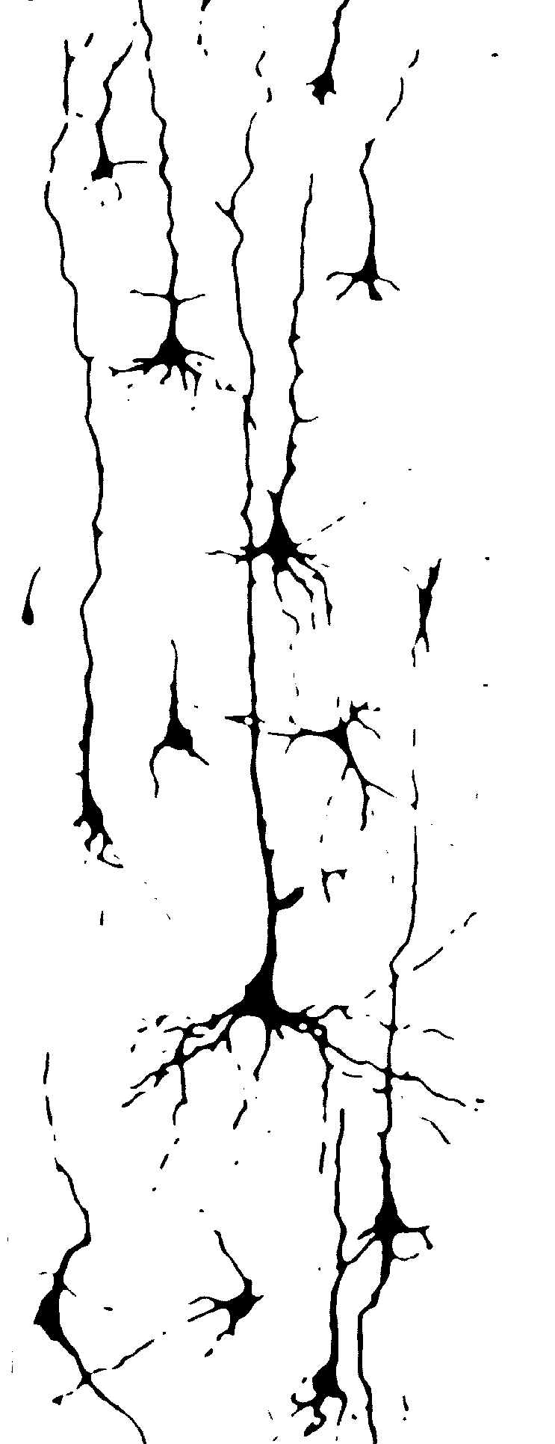
Ready For School Preschool Scholarship Human Brain Development
Brain at Birth Poorly Developed Well Developed Brain at Age 6 Brain at Age 6

Slide 11
Ready For School Preschool Scholarship
“Ready For School” Preschool Scholarship Program developed by Midland Area Community Foundation
Goal is for all children to receive at least one year of high-quality preschool prior to entering kindergarten
Midland County Great Start Collaborative provides administrative and quality oversight
Preschools must meet Michigan’s “3 Star” quality rating to receive funding for students
Approximately 400 children are underserved in Midland County
Currently 8 preschools qualified to serve RFS scholarship students in Midland County

Slide 13
Literacy and Numeracy Tutoring
Michigan enacted legislation to retain students at 3rd grade who do not demonstrate 3rd grade reading proficiency
Students learn to read from K-3rd grade; read to learn thereafter
Requirement waived during Covid and recently rescinded
Most poor readers present forms of dyslexia
~70% of US prisoners read at less than 3rd grade level
Significant debate about teaching methodologies
Utilize phonemic approach (understanding of and sounding out consonant/vowel combinations) plus visual aids
Mississippi being lauded for significant improvements using this methodology
Students who complete the program (~2 years) improve an average of ~4 grade levels in reading ability
Recently began numeracy program to complement literacy effort

Slide 14
Teen’s Brains
Not fully developed
Logical reasoning skills are well developed but,
Social maturity skills lag significantly
Consequently
Judgment is affected
Gains from risk-taking behaviors are more highly valued
Negative consequences of risky behaviors are typically disregarded/ignored

Slide 15
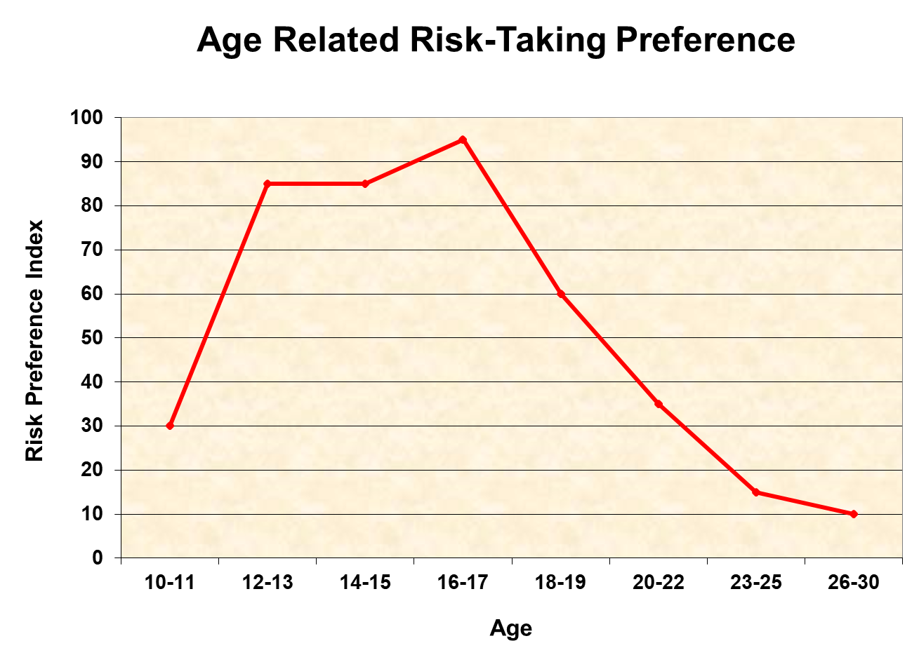
Teen Risk-Taking Behavior

Slide 16
What are Developmental Assets?
40 character traits, attributes, and influences that act as Protective Factors to reduce risk-taking behaviors among adolescents
20 External Assets
Relationships and activities in which youth engage
20 Internal Assets
Personal values and beliefs that influence and guide behavior
(Refer to Handout for specific details)

Slide 17
Developmental Asset Categories
External Assets
Support
Empowerment
Boundaries and Expectations
Constructive Use of Time
Internal Assets
Commitment to Learning
Positive Values
Social Competencies
Positive Identity

Slide 18
History
Midland County studies to determine the number of Assets and participation in 24 risk-taking behaviors conducted in 2006, 2011, 2016, 2021 among middle and high school students
Risk-taking behaviors include
Violence/Fighting
Drug use
Sexual activity
Stealing
Gambling
Self-harm
Skipping school
Depression/Suicide Ideas

Slide 20
A Framework for Youth Success
Education about negative consequences of Risk-Taking behaviors is the standard approach but is mostly ineffective
Gain from the Risk-Taking behavior is immediate
Negative consequences are deferred and only probable or even likely, but never certain
Developmental Assets correspond to vaccinations
More Developmental Assets; Fewer Risk-Taking behaviors
There is a likely hierarchy of Developmental Assets
Certain ones protect against specific Risk-Taking Behaviors
Similar to specific vaccines utilized for specific diseases

Slide 21
A Framework for Youth Success
Analysis indicates that the most impactful Developmental Assets are
Positive Peers
Restraint (Risk avoidance)
Resistance (Refusing to participate when offered)
Adult Role Models
Developmental Assets that most directly affect Positive Peers are
Creative Activities
Organized Youth Activities
Faith-Based Activities

Slide 22
A Framework for Youth Success
Recent research findings about teens (Laurence Steinberg, Distinguished University Professor and Laura H. Carnell Professor of Psychology, Temple University)
Teens value rewards much more than concerns about negative consequences
They are significantly more apt to take risks
The influence of friends profoundly affects their behavioral choices
“Think of it as an equation where consequences aren’t given the weight they should be. And when teens are around friends, that throws off the equation even more.”

Slide 23
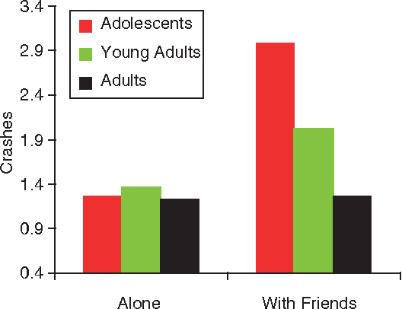
Influence of Peers
Risk taking of adolescents, young adults, and adults during a video driving game, when playing alone and when playing with friends
(Gardner & Steinberg)

Slide 25
A Framework for Youth Success
Why do Creative, Youth, and Faith-Based Activities Promote Positive Peers?
Increase probability of association with other positive youth
Expend time and energy
Include imposed structure or rules
Associated with adult role models
Provide opportunity for adult role models to “coach”—i.e., give advice that is more likely to be heeded than from family, teachers, etc.

Slide 26
A Framework for Youth Success
Results in Midland County are stunning
Developmental Assets increased sharply
Risk-Taking behaviors declined sharply
Delinquency down ~97% (from >1,000+ to ~100)
Drug arrests down ~85%
Teen pregnancies down ~63%
Re-arrest/re-offense rate down ~70%
>40%→<5% of offender’s younger siblings arrested
Over 35% improvement in standardized test scores
Considerable savings in law enforcement and justice system
Higher quality of life for youth and for the community
Safety
Security
Improved Education Outcomes
Better Health Outcomes
Other Social Cost Avoidance

Slide 27
A Framework for Youth Success
Key Points to Remember
Teens value rewards more than they are concerned about risks
More Developmental Assets = Fewer Risk-Taking Behaviors
Certain Developmental Assets affect Risk-Taking Behaviors more than others
Positive Peers are a powerful Protective Factor—Restraint and Resistance follow
Youth-serving programs and activities influence the level of Developmental Assets

Slide 28
A Framework for Youth Success
What questions may I address?

